Slide 1

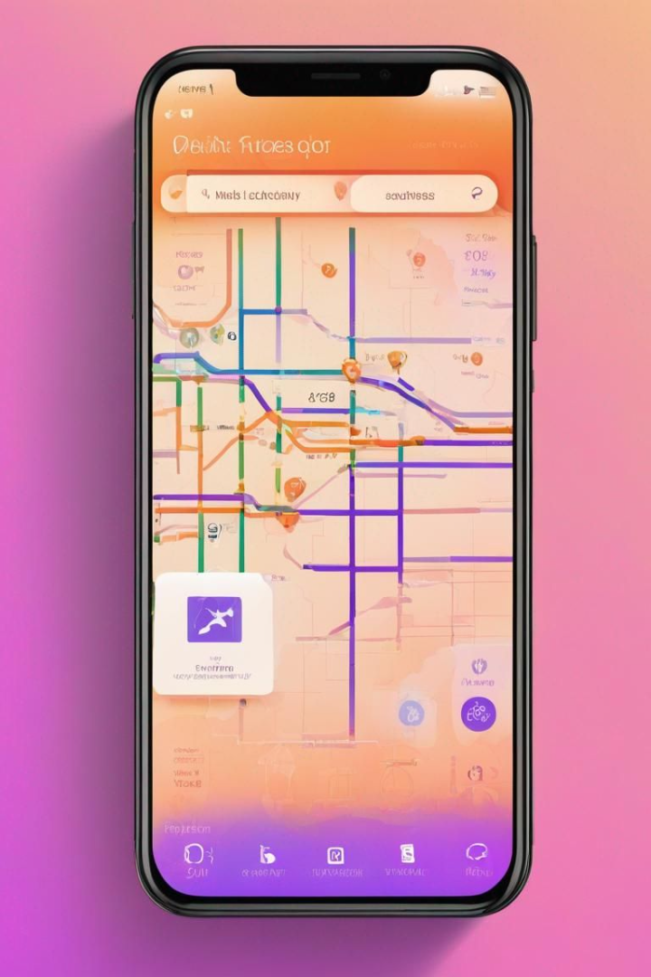
Delhi Metro Path Finder
( Project Based Learning )
Created by : Vijay Kumar Chaurasiya

Slide 2
Introduction to Delhi Metro Path Finder
The Delhi Metro Path Finder is designed with the primary objective of providing commuters a user-friendly tool to plan their metro journeys seamlessly.By leveraging advanced algorithms and real-time data, this application aims to enhance the overall commuting experience, offering convenience, accuracy, and time-efficiency.
1
Modern Route Planning
Intelligent route algorithms that calculate the quickest and most convenient routes based on user preferences.
2
Station Information
Comprehensive details about each metro station, including facilities, amenities, and nearby landmarks.
3
Fare Calculation
The Delhi Metro has become the preferred choice for many commuters due to its speed, cleanliness, and affordability.
4
Fare Calculation
Instant fare calculation based on the chosen route and ticket type.

Slide 3
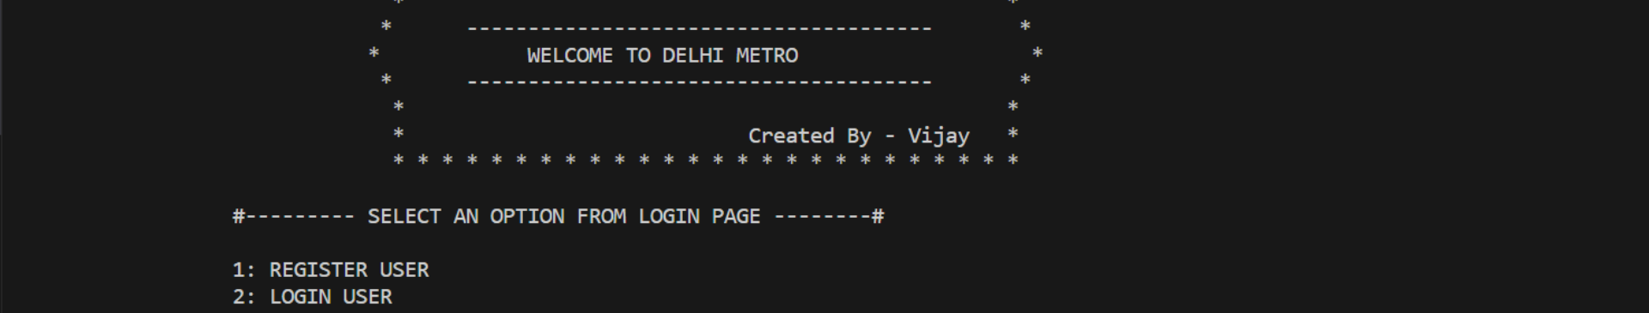
Login Page
Upon accessing the Delhi Metro Shortest Path Finder, users are presented with options to optimize their journey.
User Registration
User Login
Continue as Guest
Users can create an account to access personalized features and save their travel preferences.
Registered users can securely log in to their accounts and access their saved routes and preferences.
Guest users have the option to explore the basic features and functionalities of the application without creating an account.

Slide 4
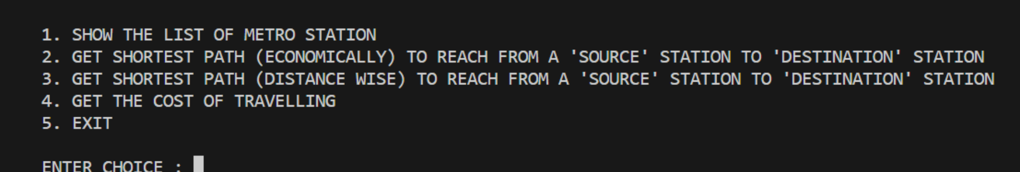
Main Menu
Choose an option from the main menu to navigate through the different modules of our Delhi Metro Path Finder app :
1. Show the list of metro stations
2. Get the shortest path (economically) to reach from a 'source' station to 'destination' station
3. Get the shortest path (distance-wise) to reach from a 'source' station to 'destination' station
4. Get the cost of traveling
5. Exit

Slide 5
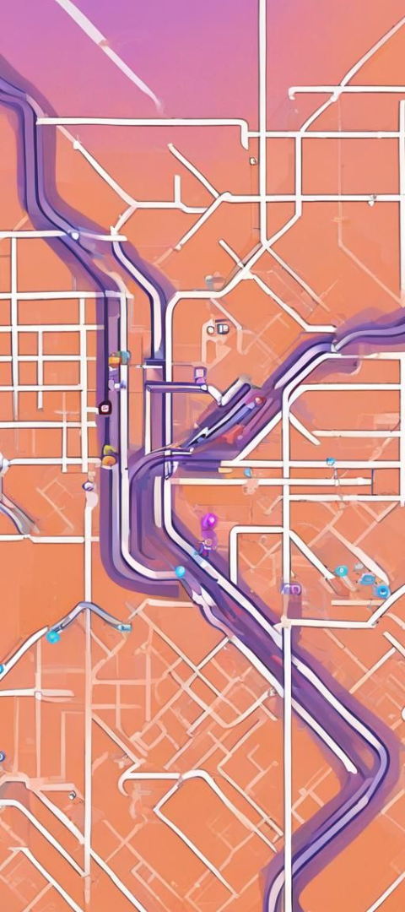
Module 1: Explore Metro Stations
Users can easily browse and explore the extensive network of Delhi Metro stations.
1
Step 1: Choose Line
2
Step 2: Find Another Line
Select the desired line based on color to view the stations within that particular route.
Select other line based on color to view the stations within that particular route.

Slide 6
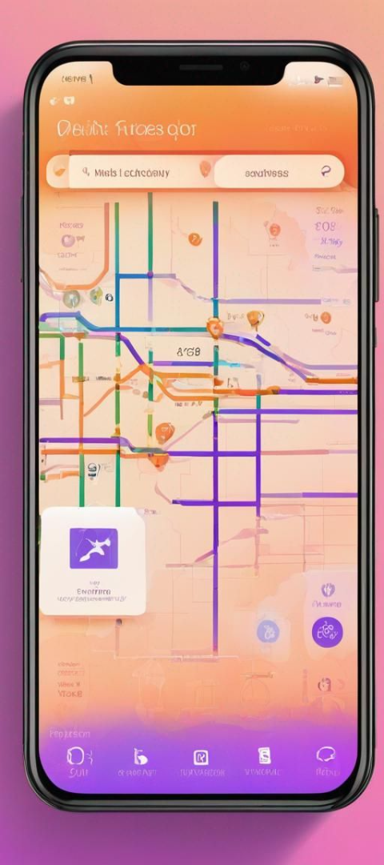


Module 2: Economical Path Finder
Find the most cost-effective route for your journey using the Delhi Metro Path Finder.
Step 1: Input Source and Destination
Enter the originating and destination stations for your planned trip.
Step 2: Generate Metro Network Graph
The system will generate a visual representation of the entire metro network.

Slide 7



Module 2: Economical Path Finder (Contd.)
Discover the shortest path using Dijkstra's algorithm for an economical journey.
Step 3: Shortest Path Calculation
Step 4: Display Path and Distance
The algorithm will calculate the shortest and most economical route based on your input.
The application will display the recommended route and the total distance for your trip.

Slide 8

Module 3: Distance-Based Shortest Path Finder
Explore route options based on the shortest physical distance between stations.
Step 1: Input Source and Destination
Enter the starting and ending stations for your intended journey.
Step 2: Generate Metro Network Graph
Generate a comprehensive visual representation of the metro network to analyze distance-based routes.

Slide 9


Module 3: Distance-Based Path Finder (Contd.)
Utilize Dijkstra's algorithm to determine the shortest path based on physical distance.
Step 3: Calculate Shortest Path
Step 4: Visualize Path and Distance
The algorithm will process the provided data to find the shortest distance between the input stations.
Visualize the shortest distance route along with the total distance for efficient travel planning.

Slide 10

Module 4: Travel Cost Estimation
The Travel Cost Estimation is a comprehensive tool designed to empower travelers with accurate and detailed cost projections for their journeys.Get precise estimates of travel costs between any two metro stations using the built-in fare calculator.

Slide 11
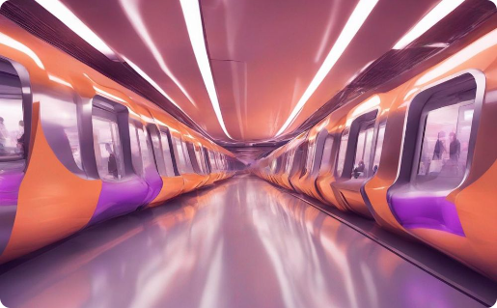
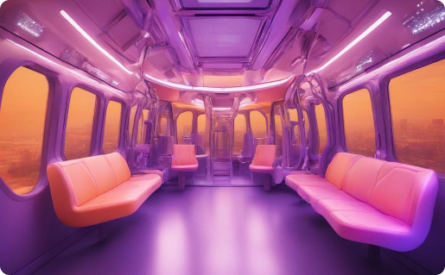

Conclusion and Future Improvements
The Delhi Metro Shortest Path Finder is a valuable tool for commuters, simplifying metro travel and enhancing the overall experience. Future upgrades may include real-time updates, accessibility features, and integration with other transit systems.
Enhanced Commuter Experience
Interactive Maps and Wayfinding:
Offline Ticketing and Smart Card Management
Efforts towards creating a seamless and enjoyable metro travel experience for all passengers.
Implement interactive maps with wayfinding features within metro stations, helping users navigate complex layouts easily.
Develop features allowing users to manage their metro smart cards and purchase tickets directly through the application, even when offline.

Slide 12

Special Thanks to KIET Group of Institutions and MR. NAVEEN CHAUHAN

